Slide 1
Overview of ASP.NET

Slide 2
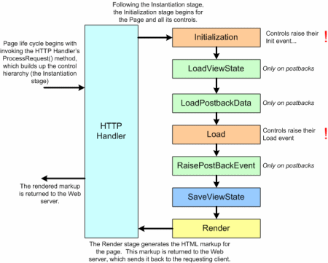
Life Cycle of ASP

Slide 3
Entity Framework

Slide 4
What is Entity Framework?
The Microsoft ADO.NET Entity Framework is an Object/Relational Mapping (ORM) framework.
It enables developers to work with relational data as domain-specific objects, eliminating the need for most of the data access plumbing code that developers usually need to write.
It is an enhancement to ADO.NET that gives developers an automated mechanism for accessing & storing the data in the database.
It works in following three senarios:

Slide 5
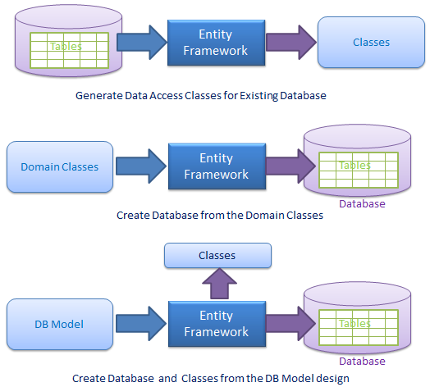
DB-First
Code-First
DB-First or
Model First

Slide 6
Implementation of Entity Framework
Create a Database first program using Entity Framework.
Create Product Table, it will have following columns:
ProductId – Integer
ProductName – String
Price – Float
Quantity – Integer
The Web Page should allow following:
Insert a Product
Update a Product
Delete a Product
Search a Product

